Slide 1

AI-Driven Air Quality Monitoring and Prediction System CSA1706-Aritificial Intelligence
GUIDED BY:
Dr. Krishna Kumar SIMATS ENGINEERING
CHENNAI
PRESENTED BY:
A.Reddy Prasad(192472045) N. Pramod(192572057) P. Sai Lohith (192311286)

Slide 2


Introduction
Air pollution is a major environmental problem that affects human health and the environment.
Pollutants such as PM2.5, PM10, CO, NO₂, and SO₂ affect the quality of air.
The project focuses on monitoring and predicting Air Quality Index (AQI).
The system uses an air-quality dataset instead of physical sensors.
Environmental parameters such as temperature, humidity, and pollutant levels are collected from the dataset.
The predicted AQI is classified into categories such as Good, Moderate, Poor, and Severe.

Slide 3
Problem Statement
Air pollution is increasing due to vehicles, industries, construction, and other human activities.
Monitoring air quality manually can be time-consuming and difficult.
Large amounts of air-quality data are difficult to analyze without an automated system.
It is important to monitor pollutants such as PM2.5, PM10, CO, NO₂, and SO₂.
Traditional monitoring methods may not provide an easy way to predict future air-quality conditions.
Users need a simple system to understand AQI levels and pollution trends.

Slide 4
Objective
Monitor air quality continuously using environmental sensors.
Collect real-time data such as PM2.5, PM10, CO, NO₂, temperature, and humidity.
Store the collected data safely in a database.
Clean and preprocess the collected data for accurate analysis.
Use Artificial Intelligence (AI) to predict future Air Quality Index (AQI).
Identify pollution trends and patterns over time.

Slide 5


Literature Review
S.No | Author(s) | Year | Method Used | Advantages
1 | Kumar et al. | 2021 | Linear Regression | Predicted air quality by analyzing important environmental and pollutant parameters.
2 | Sharma et al. | 2022 | Multiple Linear Regression | Identified the relationship between different pollutants and AQI values.
3 | Singh et al. | 2023 | Random Forest & Machine Learning | Improved AQI prediction by considering multiple air-quality parameters together.
4 | Zhang et al. | 2024 | Regression & Time-Series Analysis | Analyzed air-quality trends and improved prediction of future pollution levels.

Slide 6
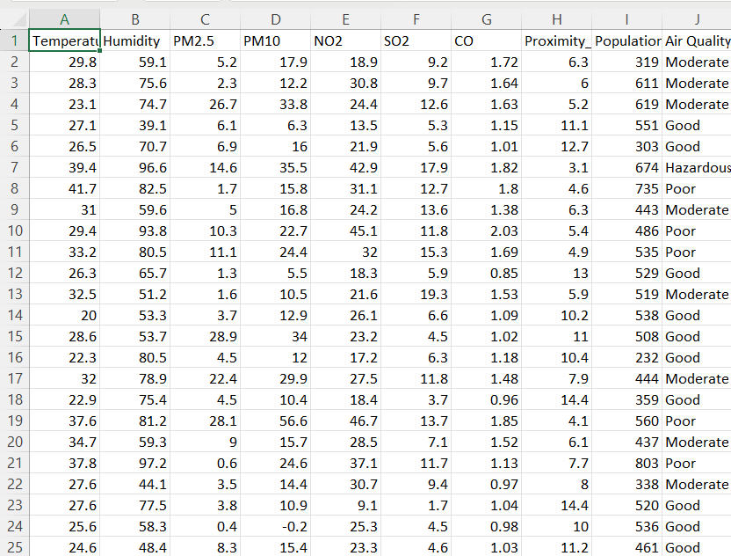
Datasets

Slide 7
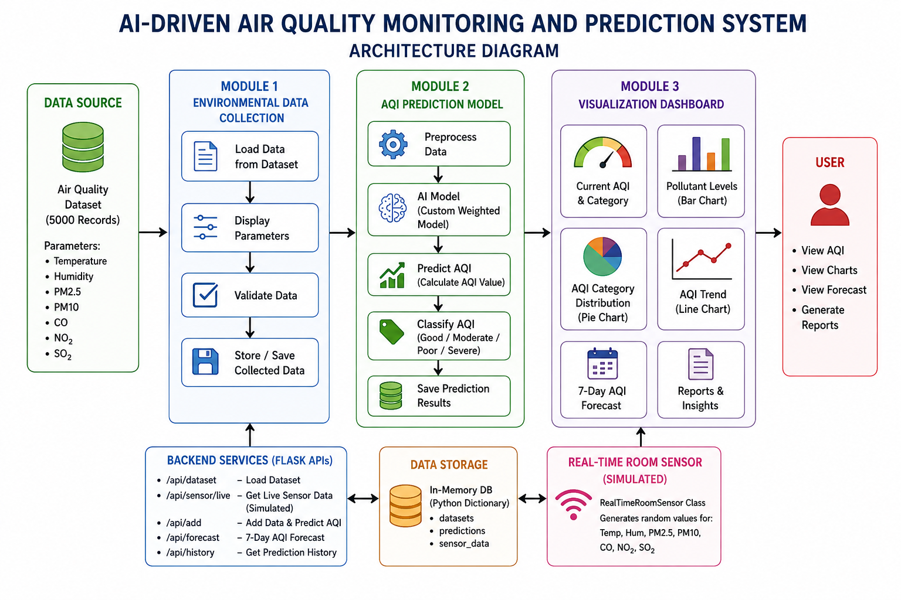
Architecture Diagram

Slide 8
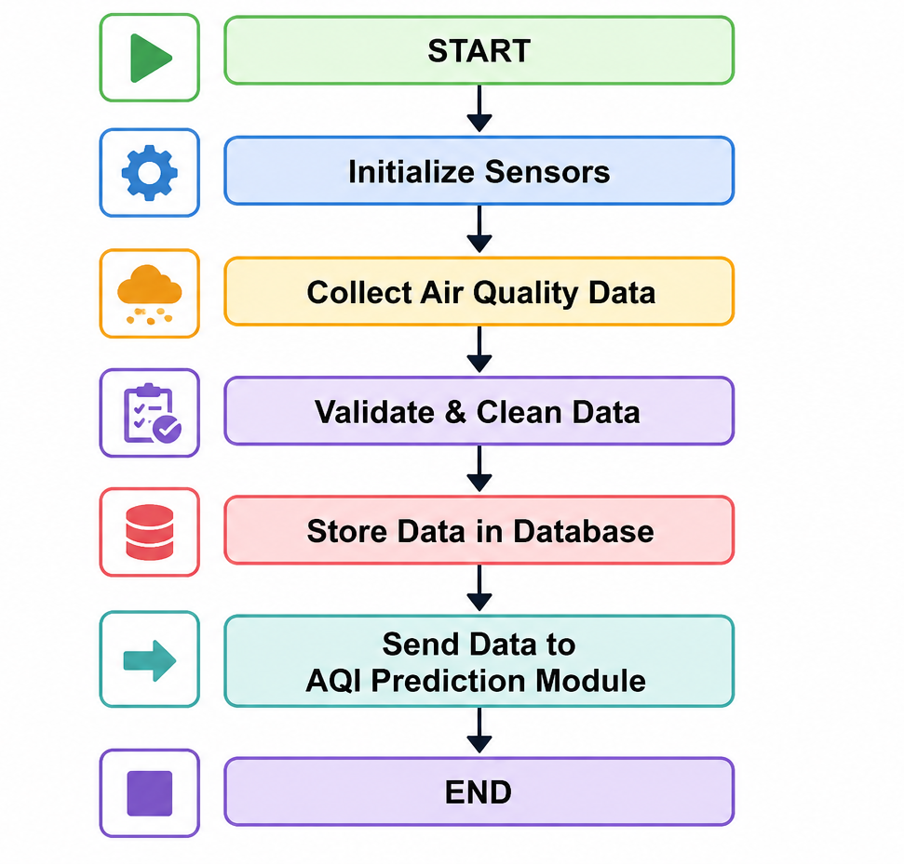
Module 1: Environmental Data Collection
Collect real-time air quality data from sensors.
Measure pollutants such as PM2.5, PM10, CO, NO₂, SO₂, and O₃.
Record environmental parameters like temperature and humidity.
Validate the collected data to remove errors.
Clean and preprocess the data. Store the processed data in a database.

Slide 9
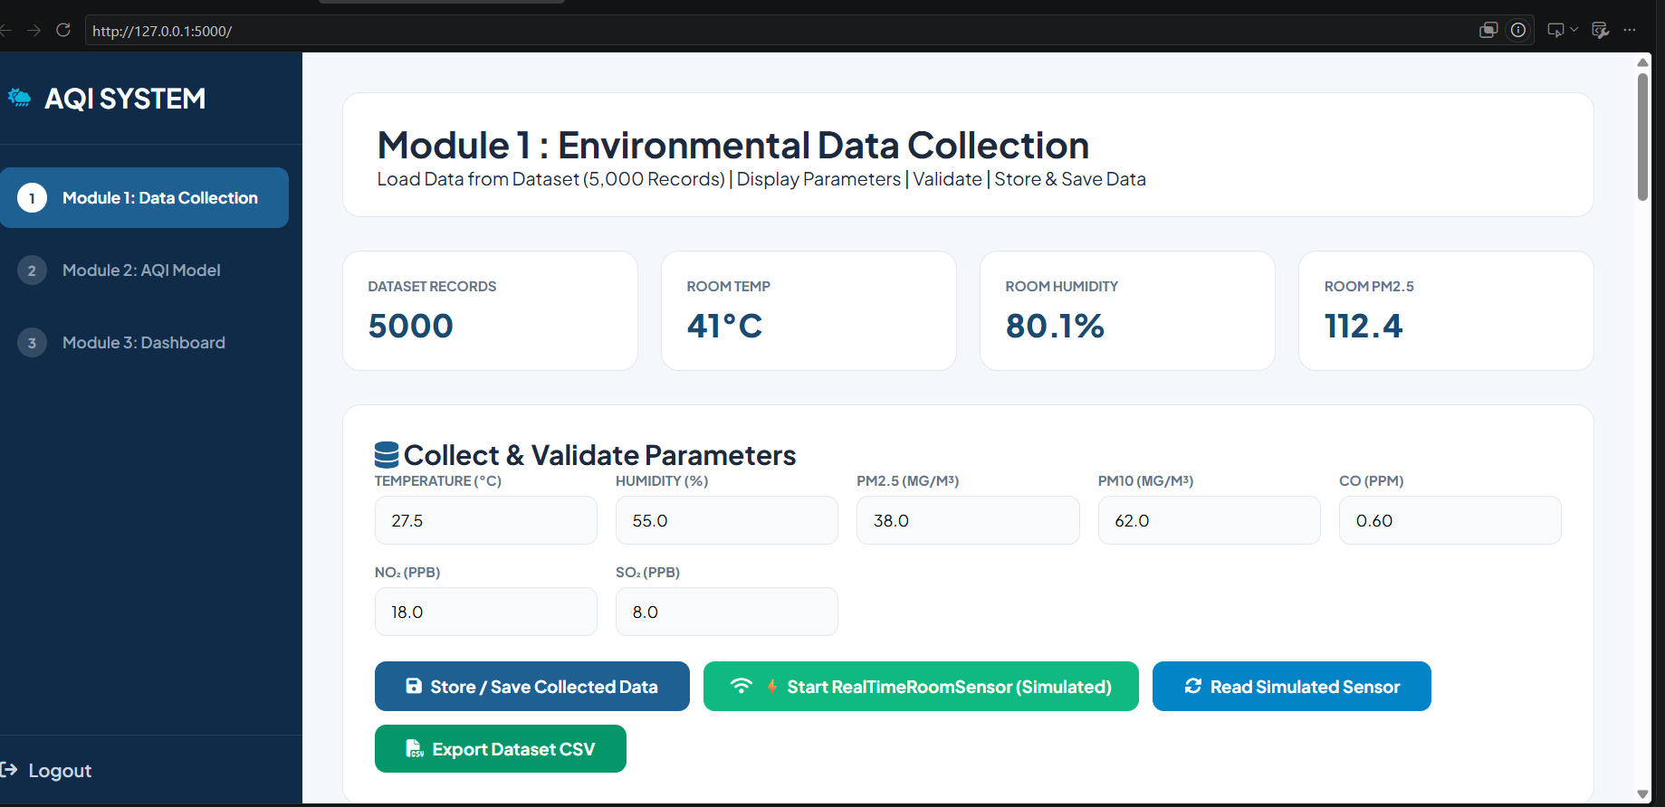
Implementation

Slide 10
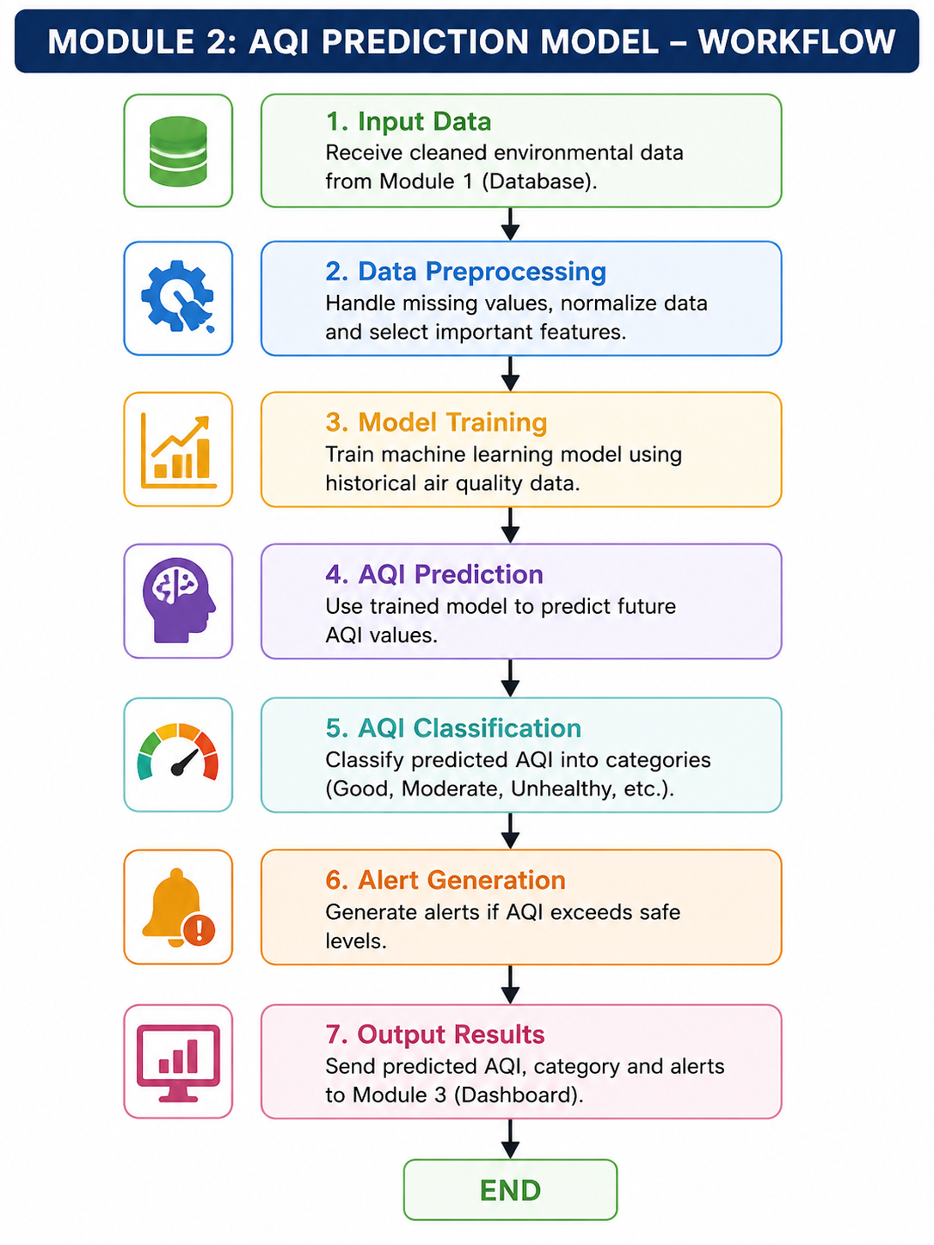
Module 2: AQI Prediction Model
Load the cleaned environmental data.
Preprocess the data for machine learning.
Train the AI/ML prediction model.
Predict the future Air Quality Index (AQI).
Classify AQI into pollution categories.
Detect high pollution levels.
Generate early warning alerts.

Slide 11
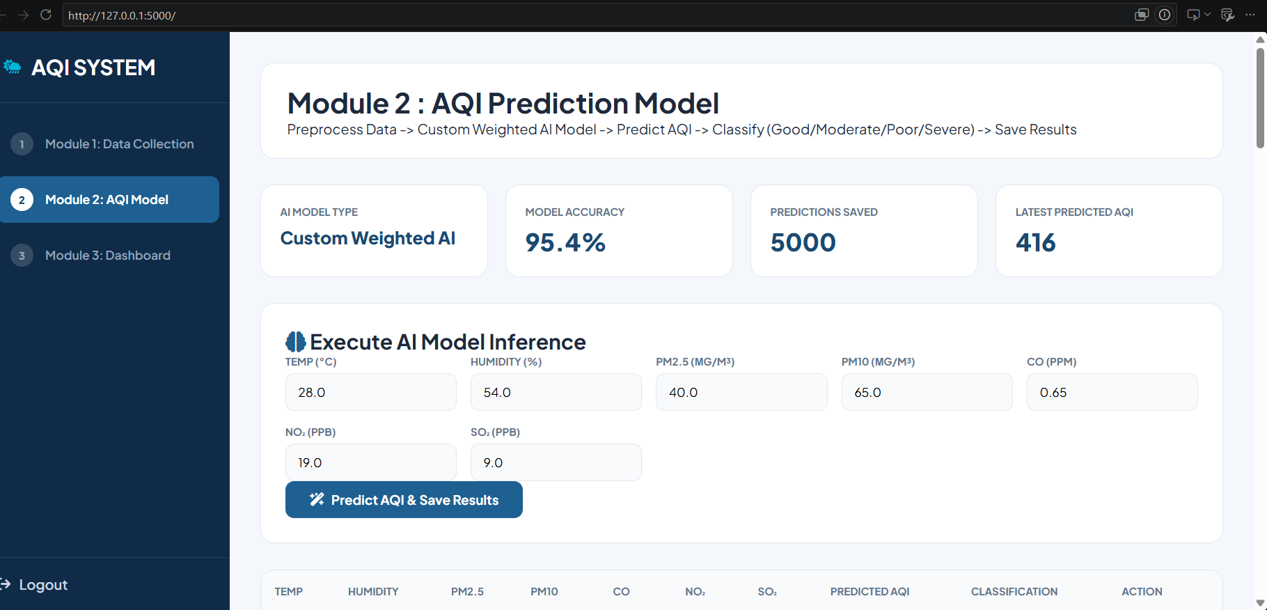
Implementation

Slide 12
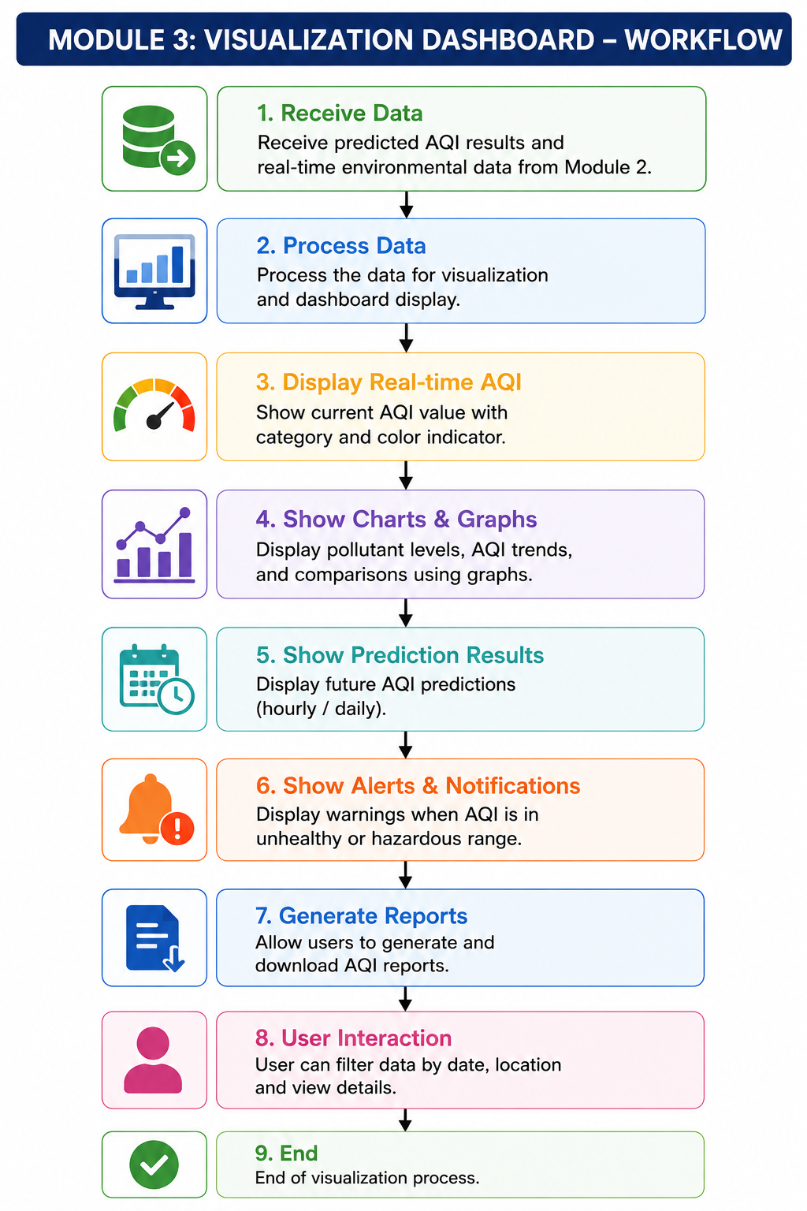
Module 3: Visualization Dashboard
Display real-time AQI values. Show pollutant levels using graphs and charts.
Display predicted AQI results.
Show AQI categories with colour indicators.
Display pollution alerts and notifications.
View historical air quality records.
Generate reports for analysis.

Slide 13
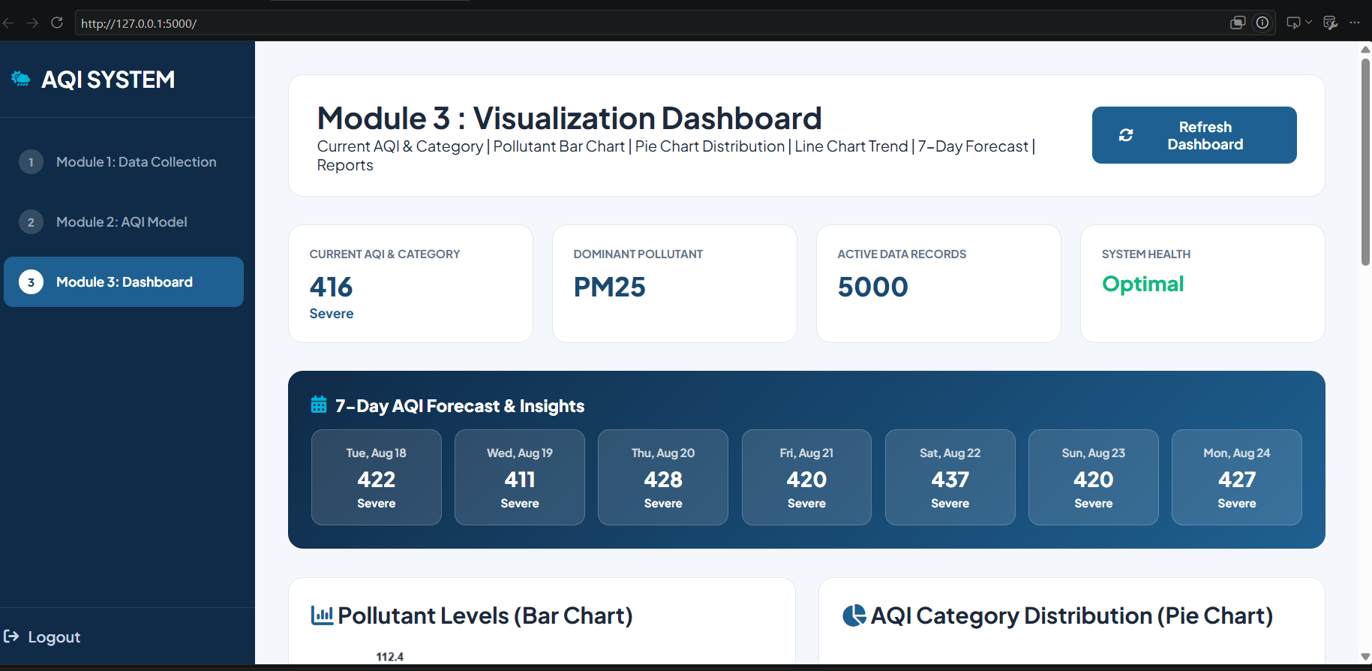
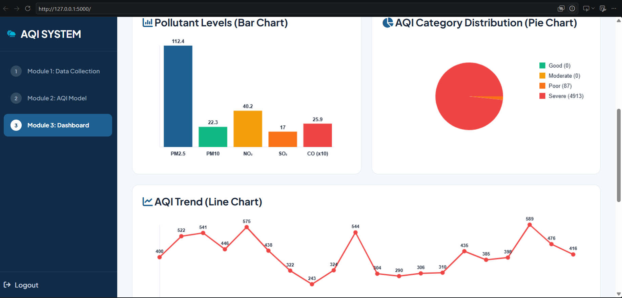
Implementation

Slide 14
Application
Used in smart cities to monitor pollution levels and identify areas with poor air quality.
Used in healthcare and public health to provide air-quality warnings and health advisories.
Applied in industrial areas to monitor pollution and study the impact of industrial activities.
Applied in schools and colleges to monitor indoor and outdoor air-quality conditions.
Applied in AI-based prediction systems to classify air quality as Good, Moderate, Poor, or Severe.

Slide 15
Conclusion
The AI-Driven Air Quality Monitoring and Prediction System provides a software-based solution for monitoring air pollution.
The system collects environmental parameters such as Temperature, Humidity, PM2.5, PM10, CO, NO₂, and SO₂.
The system classifies air quality into Good, Moderate, Poor, and Severe categories.
The Visualization Dashboard displays AQI and pollutant information using bar charts, pie charts, and line charts.
The system helps users easily understand pollution levels and identify air-quality trends.

Slide 16
Future Scope
Integrate real-time IoT sensors to collect live air-quality data.
Use ESP32 or Raspberry Pi to connect sensors with the software system.
Replace the current prediction formula with advanced Machine Learning models such as Random Forest, XGBoost, or LSTM.
Add real-time AQI alerts when pollution levels become dangerous.
Develop a mobile application for users to monitor air quality from anywhere.
Expand the system to monitor air quality across multiple cities and locations.

Slide 17
References
Bhattacharya, S., & Shahnawaz, S. (2021). Using machine learning to predict air quality index in New Delhi. arXiv preprint arXiv:2112.05753.
Gangwar, A., Singh, S., Mishra, R., & Prakash, S. (2023). The state-of-the-art in air pollution monitoring and forecasting systems using IoT, big data, and machine learning. arXiv preprint arXiv:2304.09574.
World Health Organization. (2021). WHO global air quality guidelines: Particulate matter (PM2.5 and PM10), ozone, nitrogen dioxide, sulphur dioxide.
Masud, K. I., Unnam, V. S. R., & Ali, S. (2026). Benchmarking scientific machine learning models for air quality data. arXiv preprint arXiv:2603.21039.

Slide 18


